Slide 1


Lesson 8-1
The Halting Problem
Theory of Computation
王轩
Wang Xuan

Slide 2
Outline
Unsolvable
Undecidable Languages
A_{TM} is Turing-recognizable
Universal Turing Machine
The Halting Problem is Undecidable
R is uncountable
The set of all languages is uncountable
Diagonalization method
Turing-unrecognizable Language
‾A_{TM} is not Turing-recognizable

Slide 3
Unsolvable
Several ordinary problems are computationally unsolvable
In this section and Chapter 5 you will encounter several computationally unsolvable problems.
Our objectives are to help you develop a feel for the types of problems that are unsolvable and to learn techniques for proving unsolvability.

Slide 4
Undecidable Languages
undecidable language = not decidable language
There is no decider:
There is no Turing Machine which accepts the language and makes a decision (halts) for every input string
(machine may make decision for some input strings)

Slide 5
For an undecidable language, the corresponding problem is undecidable (unsolvable):
there is no Turing Machine (Algorithm) that gives an answer (yes or no) for every input instance
(answer may be given for some input instances)

Slide 6


We have shown before that there are
undecidable languages:
Turing-Acceptable
Decidable
is Turing-Acceptable and undecidable

Slide 7





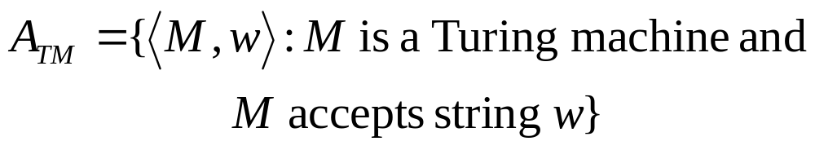
Input:
Turing Machine
String
Question:
Does accept ?
Corresponding language:

Slide 8
A_{TM} is Turing-recognizable
Turing machine U recognizes A_{TM}
U = “ on input <M,w>, where M is a TM and w is a string:
  1. Simulate M on input w.
  2. If M ever enters its accept state, accept; if M ever enters its reject state, reject.”
TM U
TM M
accept
accept
w
reject
reject
loop

Slide 9
Halting Problem
This machine loops on input <M,w> if M loops on w, which is why this machine does not decide A_{TM}.
A_{TM} is sometimes called the halting problem.
A_{TM} is undecidale and A_{TM} is recognizable. Thus recognizers are more powerful than deciders.

Slide 10
Universal Turing Machine
Turing machine U is an example of Universal Turing Machine (U_{TM})
U_{TM} is capable of simulating any other Turing machine from the description of that machine.
It plays an important early role in stimulating the development of stored-program computers

Slide 11

The Halting Problem is Undecidable
A_{TM}={<M,w>| M is a TM and M accepts w}.
Proof by contradiction.
Suppose that H is a decider for A_{TM}.
Construct Turing machine D with H as a subroutine. D calls H to determine what M does when the input to M is its own description <M>.

Slide 12
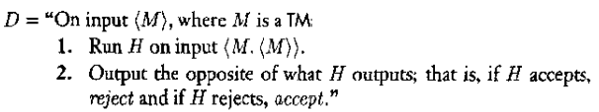

The description of D
We obtain

Slide 13

Run D with its own description <D>. We get
No matter what D does, it is forced to do the opposite.
  D rejects <D> exactly when D accepts <D>.
There is a contradiction.

Slide 14
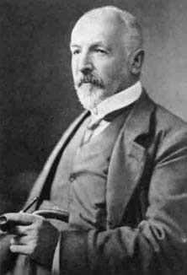
The Diagonalization Method
Georg Cantor in 1873
Measuring the sizes of infinite set
  Finite sets is easy
  Infinite sets:
    Set of natural numbers {1,2,3…}
    Set of even natural numbers {2,4,6…}
Two finite sets have the same size if the elements of one set can be paired with the elements of the other set.
Extending to infinite sets

Slide 15
Definition
Sets A and B, function f from A to B
f is one-to-one, if f(a)‡f(b) whenever a‡b.
f is onto, if for every b∈B there is an a∈A such that f(a)=b.
A and B are the same size if there is a one-to-one, onto function f: A->B.
Function that is both one-to-one, and onto is called correspondence.
Notes:
One-to-one一对一映射 onto:满射 correspondence:对应

Slide 16
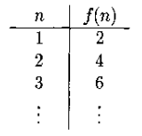
Example
Natural numbers N {1,2,3…} & Even natural numbers {2, 4,6,…}
Same size. Correspondence f map N to the set of even natural numbers is f(n)=2n.
A set A is countable if either it is finite or it has the same size as N.
Notes:
标注 ε 的含义

Slide 17
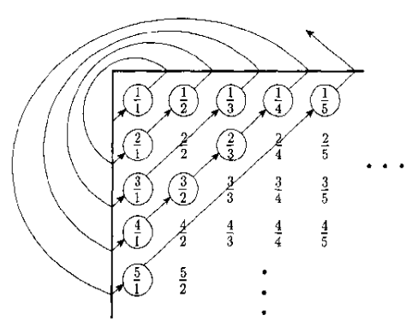
Another Example
Q=[m/n| m, n∈Ν] be the set of positive rational numbers.
We need to give a correspondence with N to show that Q is countable

Slide 18
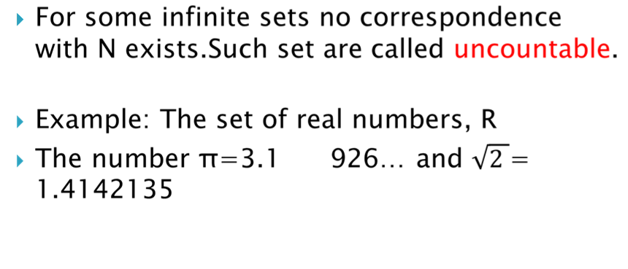
Uncountable
415

Slide 19
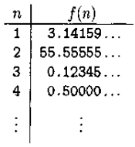
R is uncountable
Show that no corresponding exists between N and R.
Proof by contradiction.
Suppose that a correspondence f existed between N and R. We can find an x in R that is not paired with anything in N.
Suppose

Slide 20
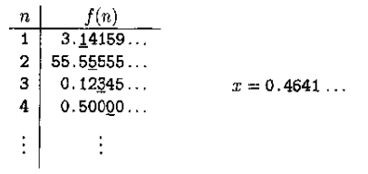
Cont.
Construct x by giving its decimal representation.
To ensure x≠f(1), let the first digit of x be different from the first fractional digit 1 of f(1)=3.14159. Let it be 4
To ensure x≠f(2), let the second digit of x be different from the second fractional digit 5 of f(2)=55.555555. Let it be 6.
Continue …

Slide 21
We get x is not f(n) for any n because it differs from f(n) in the nth fractional digit.
Done
Notes:
fractional 部分的，分数的，小数的

Slide 22
IDEA：Some languages are not Turing-recognizable
1. The set of all strings Σ* is countable, for any alphabet Σ.
2. The set of all Turing machines is countable.
3. The set of all languages is uncountable.
Thus, some languages are not recognized by any Turing machine.

Slide 23
Proof
The set of all strings Σ* is countable, for any alphabet Σ
  Form a list of Σ* by writing all strings of length 0, length 1, length 2, and so on
The set of all Turing machines is countable
  Each Turing machine M has an encoding into a string <M>. Turing Machine Encoding
  Remove the illegal encodings

Slide 24
The set of all languages is uncountable
The set of all languages
  Let B be the set of all infinite binary sequences.
Let L be the set of all languages over alphabet Σ.
Suppose L is a correspondence with B.
Let Σ* = {s₁, s₂, s₃,…}. Each language A∈L has a unique sequence in B. The i^{th} bit of that sequence is a 1 if s_{i}∈A and is a 0 if s_{i}∉A. We call it characteristic sequence x_{A} of A.

Slide 25

Cont.
If A is the language of all strings starting with a 0 over the alphabet {0,1}, its character sequence x_{A} would be
The function f: L->B, where f(A) equals the characteristic sequence of A and is a correspondence. Therefore, as B is uncountable, L is uncountable as well.

Slide 26
The set of all languages is uncountable.
The set of all Turing machines is countable.
Thus, some languages are not recognized by any Turing machine.

Slide 27
Turing-unrecognizable Language
A language is co-Turing-recognizable if it is the complement of a Turing-recognizable language.
Theorem: A language is decidable iff it is Turing-recognizable and co-Turing-recognizable.
In other words, a language is decidable if and only if both it and its complement are Turing-recognizable.

Slide 28
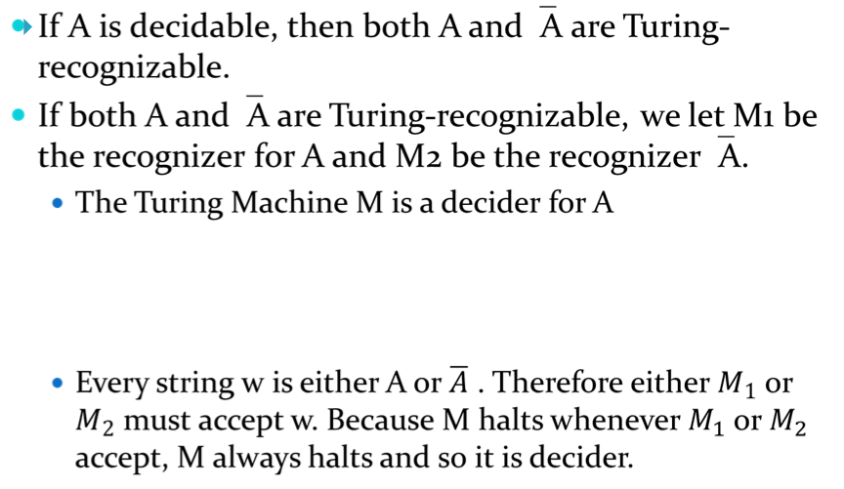

Proof (two directions)

Slide 29
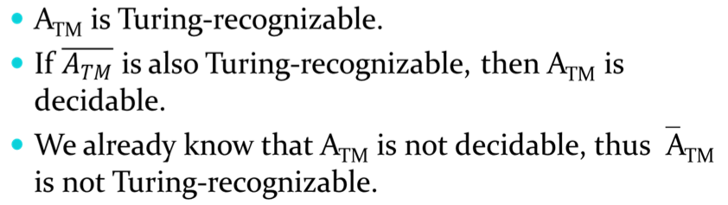
‾A_{TM} is not Turing-recognizable
Proof

Slide 30
Review
Unsolvable
Undecidable Languages
A_{TM} is Turing-recognizable
Universal Turing Machine
The Halting Problem is Undecidable
R is uncountable
The set of all languages is uncountable
Diagonalization method
Turing-unrecognizable Language
‾A_{TM} is not Turing-recognizable

